Slide 1
Middle Eastern and North African Literature
An Overview

Slide 2
Middle Eastern Literature
Major Characteristics
  Oral tradition
    Role of rawi (professional reciters)
  Invention of writing
    Cuneiform (Mesopotamia)
      Pictographs
      Ideograms
    Hieroglyphics and Hieratics (Egyptian)

Slide 3
Middle Eastern Poetic Genres
Qasida – an ode, composed in varied meters and with a single rhyme, that is, all lines end in the same rhyming sound
Elegy – a lament, especially for the dead, usually composed by a woman, most often the dead hero’s sister

Slide 4
Middle Eastern Poetic Genres (continued)
Ghazal – a short lyric, usually dealing with love, composed in a single rhyme and based on the poet’s personal life and loves
Rubai – a quatrain (four-line) verse, popular in Persian literature

Slide 5
Middle Eastern Prose Genres
Adab – an Arabic word meaning “rules of conduct,” “manners,” or “good habits”; in Modern Arabic it refers to the whole of literature
Ayyam al-’Arab – “The Days of Arabs”; tales of tribal warfare
Musamarah – “night conversations”; loosely organized around a conventional theme, it is filled with puns, literary allusions, and colorful vignettes of tribal life

Slide 6
Middle Eastern Prose Genres (continued)
Maqamah – created by al-Hamadhani (969-1008 CE), it is comprised of stories of rogues and conmen filled with wordplay, humor, and keen usage of Arabic language and grammar
“Mirror of Princes” – a Persian genre popular from 1000 to 1400 CE that served as a guide for enlightened rules which focused on real and legendary statesmen, presenting them as models of refinement and good habits

Slide 7
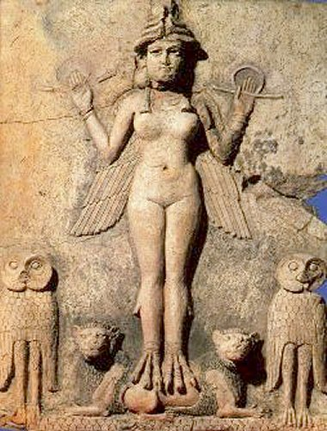
The Hymn to Inanna
Genre: Hymn
Poet: Enheduanna (b. ca, 2300 BCE)
Synopsis: a hymn of praise to the moon goddess, Inanna; Enheduanna is the earliest identified author of either sex in world literature

Slide 8
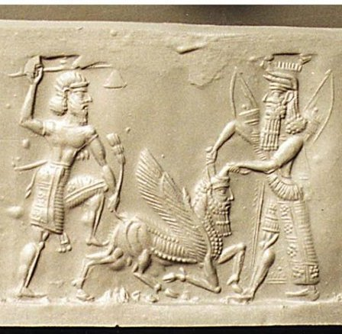
The Epic of Gilgamesh
Genre: Epic Poetry
Poet: Anonymous (the poem was inscribed by Sin-Leqi-Unninni ca. 700 BCE)
Synopsis: an epic tale of the life of the Sumerian King of Uruk, Gilgamesh

Slide 9
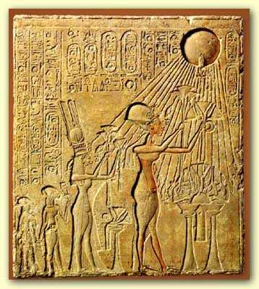
The Hymn to Aten
Genre: Lyric Poetry
Poet: Unknown
Synopsis: a poem praising the sun god, Aten

Slide 10
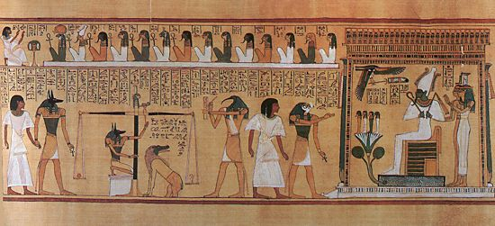
The Egyptian Book of the Dead
Genre: Sacred Text
Author: Unknown
Synopsis: also called the “coming forth by day” book, this text was meant to ensure life beyond death

Slide 11
Ancient Egyptian Love Poetry
Work: Untitled Poem No. 1
Work: Untitled Poem No. 2

Slide 12
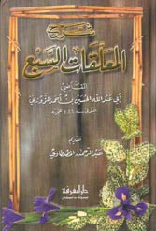
al-Mu’allaqat (“The Hanged Poems” or “The Seven Odes”)
Genre: collection of odes
Poet: unknown
Synopsis: a collection of Pre-Islamic odes alleged to have been suspended on the walls of the Kaaba

Slide 13
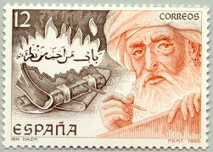
The Ring of the Dove
Genre: hybrid of poetry and prose
Author/Poet: Ibn Hazm (994-1064 CE)
Synopsis: a hybrid of poetry and prose which focuses on the art of love

Slide 14
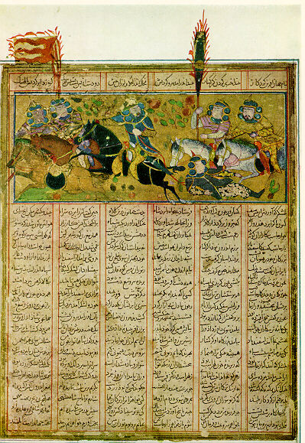
Shanimah (Shah Nama)
Genre: Epic Poem
Poet: Firdausi (Abul Kasim Mansur) (941? CE-1020? CE)
Synopsis: an epic recounting of Persian kings and heroes; it is also known as “The Book of Kings”

Slide 15
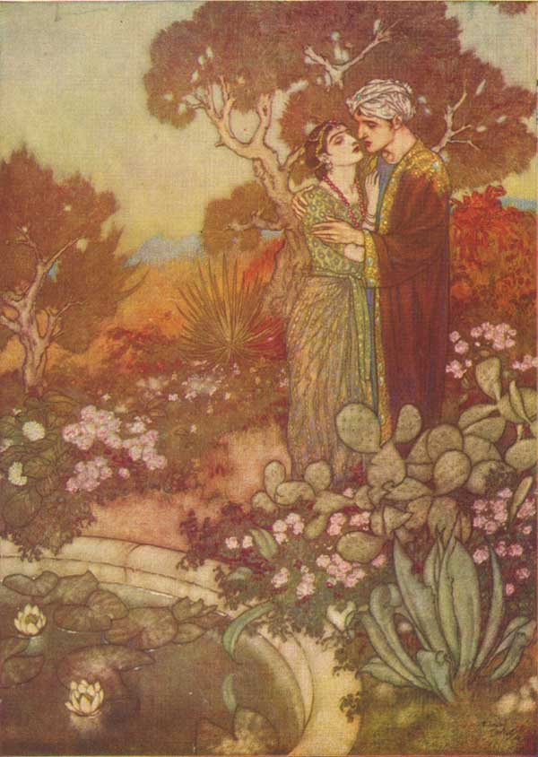
The Rubaiyat
Genre: Lyric Poetry
Poet: Omar Khayyam (ca. 1048-1131 CE)
Synopsis: a collection of rubai (quatrains) on a variety of subjects

Slide 16
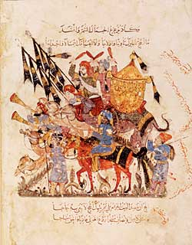
Maqamat or The Assemblies of al-Hariri
Genre: Maqamah
Author: al-Hariri (1054-1122 CE)
Synopsis: the adventures of the learned rogue and vagabond Abu Zayd, as reported by a narrator, al-Harith

Slide 17
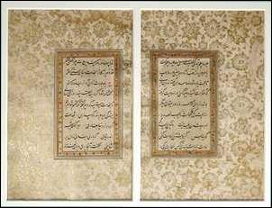
The Gulistan (The Rose Garden)
Genre: Adab
Author: Sadi (1200? CE-1292? CE)
Synopsis: a compendium of worldly wisdom used for instruction and amusement

Slide 18
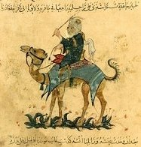
The Journal of Ibn Battuta
Genre: Journal/Travelogue
Author: Ibn Battuta (1304-1369 CE) [dictated to Ibn Juzayy]
Synopsis: a travelogue spanning 3 decades and 75,000 miles

Slide 19
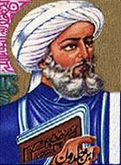
Muqaddimah (Introduction to History)
Genre: Historiography
Historian: Ibn Khaldun (1332-1406 CE)
Synopsis: an account of the factors necessary for interpreting history

Slide 20
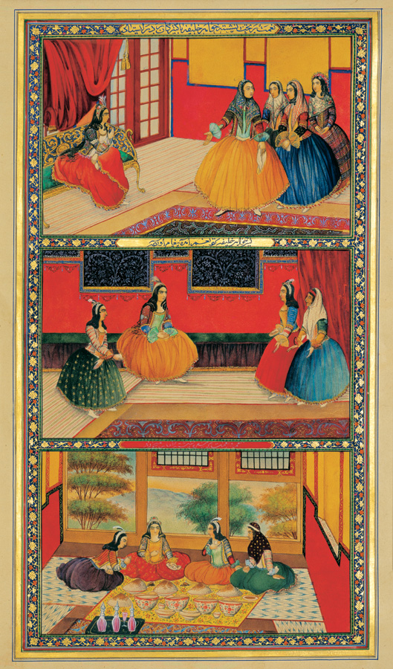
The Thousand and One Nights
Genre: Prose Collection of Stories
Author: Unknown
Synopsis: Shahrazad tells tales to prevent being murdered by King Shahryar

Slide 21
Islamic Poets
Al-Khansa (d. after 630 CE) – a female poet noted for her elegies about her father and two brothers
Jamil (d. 701 CE) – a male poet whose ghazals set the standard for later writers
Rabi’a al-Adawiyya (717-801 CE) – a female Sufi mystic and teacher known for her asceticism
  Three Selections

Slide 22
Islamic Poets (continued)
Jelaluddin Rumi (1207-1273 CE) – a Persian poet and Sufi mystic noted for:
  Diwan-e Shams – a collection of poems addressed to a Sufi holy man and the poet’s master
  Masnavi-ye Ma’navi (Mathnawi) – “Spiritual Couplets” which is part Sufi handbook and part anthology of proverbs and folktales

